Slide 1

FIRE Analysis 🔥
Pamela Moreno
Raj Mohapatro
Jean-Christophe Mignon

Slide 2
Motivation & Summary
James an average person is looking to see if there is an alternative option that he can retire earlier based on his age, savings and lifestyle.
James has done some calculations on his Superfund, but has found that, it will take a lot of time to achieve his goal, so he decided to look out for an alternative investment strategy.
James is whiling to take some risk and would like to see if investing into the Market would help him to achieve his goal. He would like then to use a tool that can predict him how he would end up in the next 10, 20 and 30 years based on an initial investment and savings every year.
James, is also thinking that if he could save a bit of money on cost living, he would end up with more and having a good retirement life. So for that, James would like to analysis the cost living expenses in different countries and see if he better off moving into another country.

Slide 3
Motivation & Summary
Questions:
When would you like to retire?
If you would like to retire sooner, would Superannuation be the best retirement plan?
What would be an alternative investment strategy for retirement plan?
Would the Market be a good alternative for investment and what would be its risk?
How much returns would you have if investing into the Market over next 10, 20 & 30 years?
Could a new relocation be a good option to save more money?
What would the more affordable places?
What location can I afford based on my savings?

Slide 4
Questions & Data
Elaborate on the questions you asked, describing what kinds of data you needed to answer them and where you found it. >> TO BE DELATED
Personal Analysis Data: (JC)
Market Analysis & Retirement Tool Data :
We used yfinance to fetch historical data of 5 major Indexes market. We used then https://au.finance.yahoo.com/ and collected the data history of S&P500, NASDAQ Composite, S&P/ASX 200, Dow Jones Commodity & BTC.
Cost of living analysis Data: (Raj)

Slide 5
Data Cleanup & Exploration
Describe the exploration and cleanup process.
Discuss insights you had while exploring the data that you didn't anticipate.
Discuss any problems that arose after exploring the data, and how you resolved them.
Present and discuss interesting figures developed during exploration, ideally with the elp of Jupyter Notebook. >> to be delated
Personal Df: (JC) >>
Indexes Analysis: at first, we tried to use Alpaca to get the data history of the selected Indexes market, but this was not possible due to Alpaca does not contain Indexes Tickers. So instead, we used yfinance and get data from https://au.finance.yahoo.com/.
We then, started cleaning it up and selected “close” price to start our analysis. Some other changes was colunms names.

Slide 6
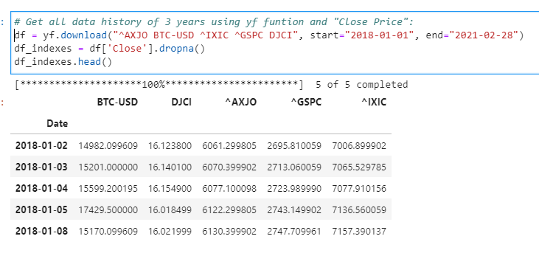
Data Cleanup & Exploration
For our retirement plan tool data, we found out that the data levels are opposite to what MCSimulation is structured, so we had to swapped levels and changed names to lower case:

Slide 7
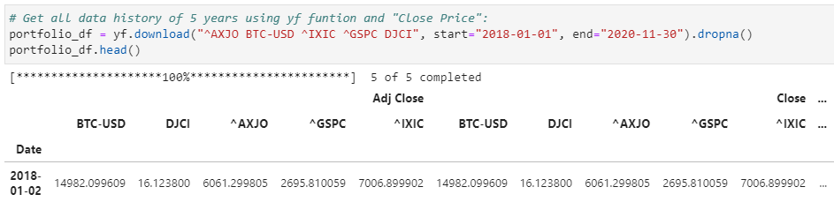
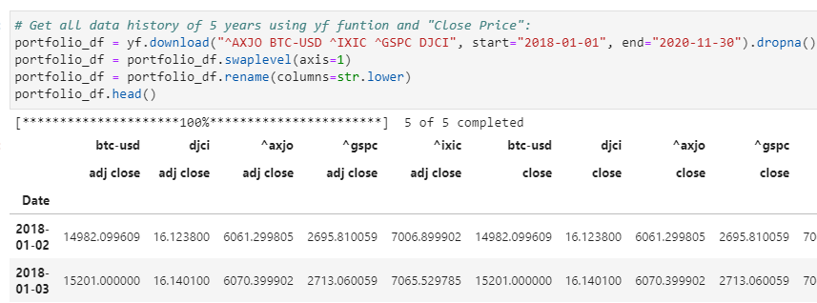
Data Cleanup & Exploration
First Df →
← Second Df

Slide 8
Data Cleanup & Exploration
Cost of living analysis Data (Raj)

Slide 9
Data Analysis
Discuss the steps you took to analyze the data and answer each question you asked in your proposal.
Present and discuss interesting figures developed during analysis, idealy with the help of Jupyter Notebook.
>> to be delated
Personal Analysis Data: (JC)
Part 1 – Indexes Analysis:
Indexes:
1. S&P500 (GSPC).
2. NASDAQ Composite (IXIC).
3. S&P/ASX 200 (ASX).
4. DJCI (Dow Jones Commodity)
5. BTC.

Slide 10
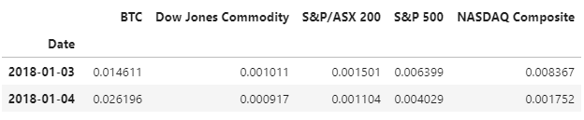
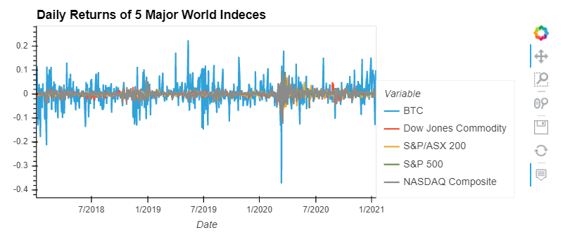
Data Analysis
We have analysed these major indexes to determine their performance in multiple areas: volatility, returns, risk, and Sharpe ratios
Daily Returns

Slide 11
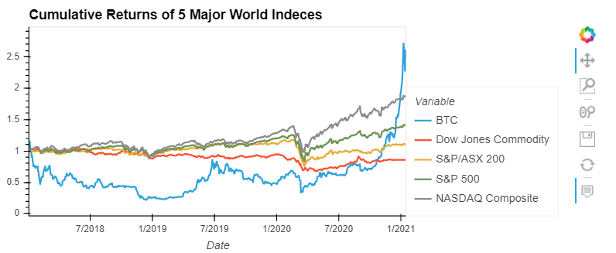

Data Analysis
Cumulative Returns →
← Risk Analysis: Standard Deviation

Slide 12
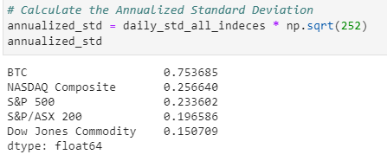
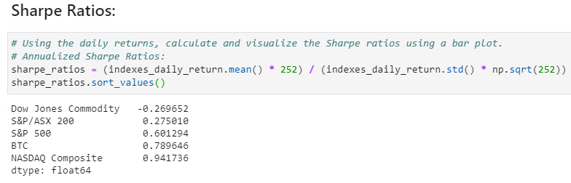
Data Analysis

Slide 13
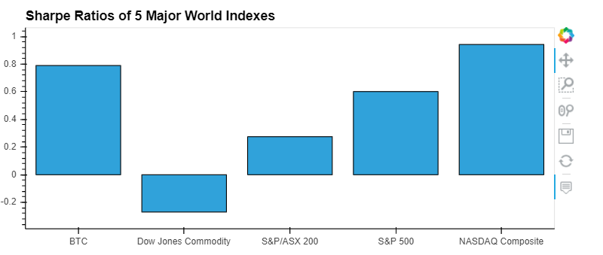
Data Analysis

Slide 14
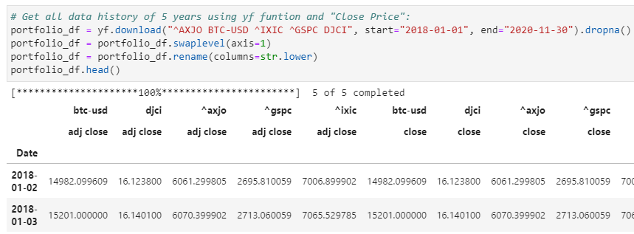
Data Analysis
Part 2 - Retirement Plan Tool:

Slide 15
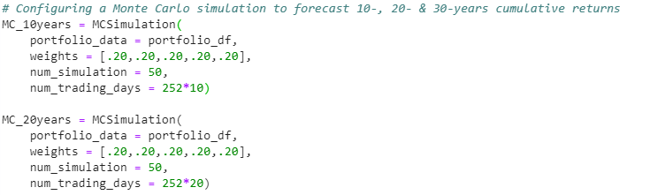
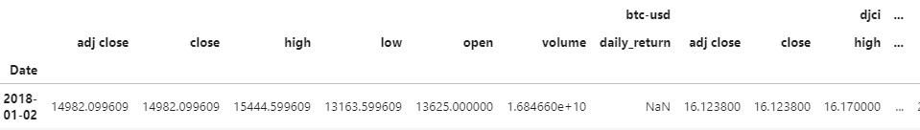
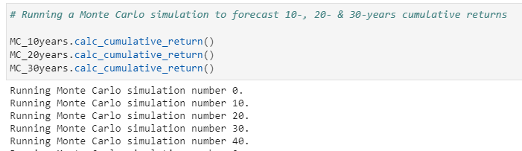
Data Analysis

Slide 16
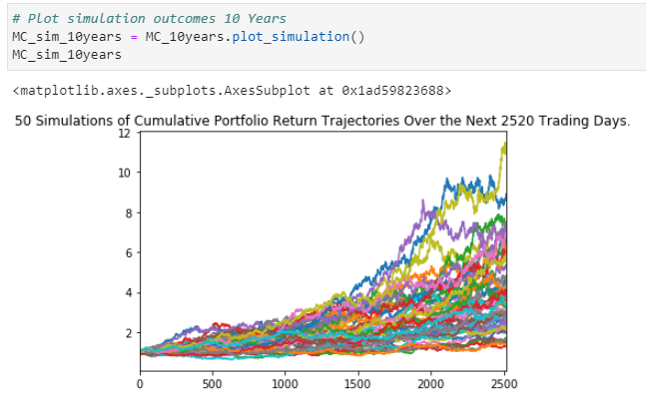
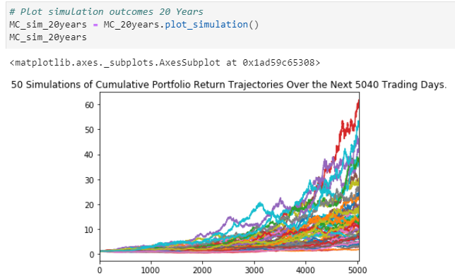
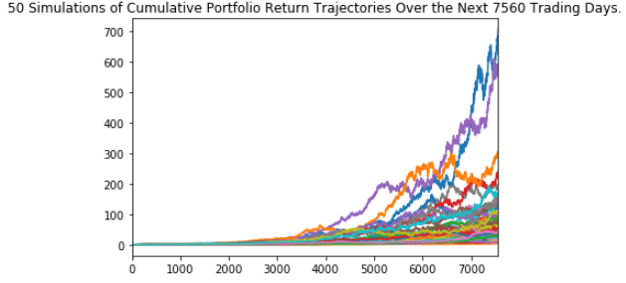
Data Analysis

Slide 17
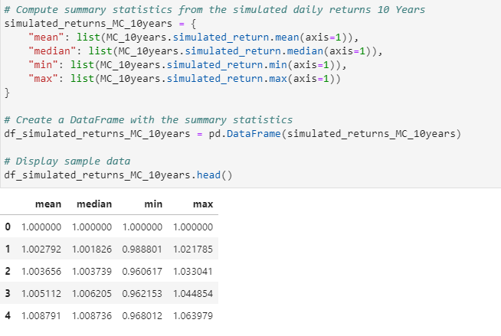
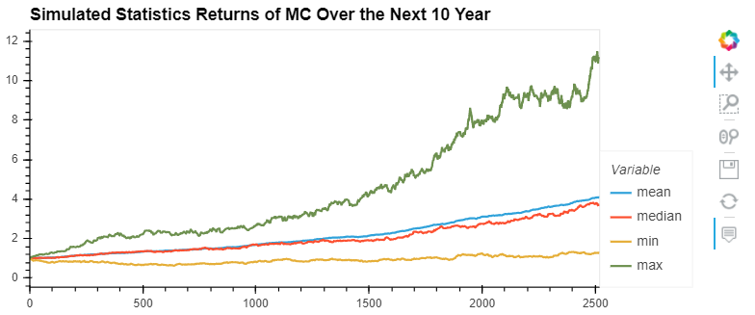
Data Analysis
Retirement Analysis:

Slide 18
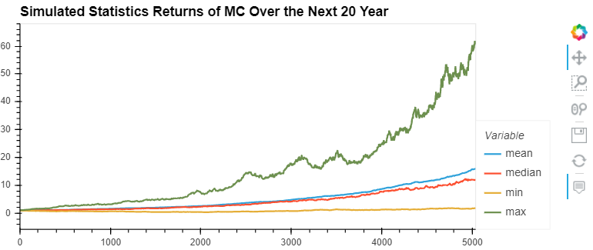
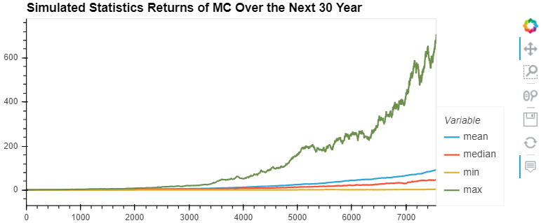
Data Analysis

Slide 19
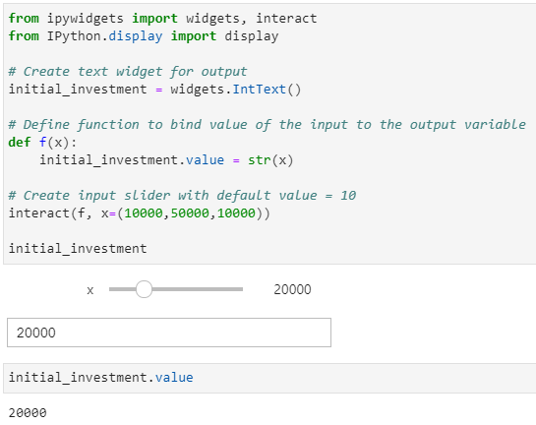
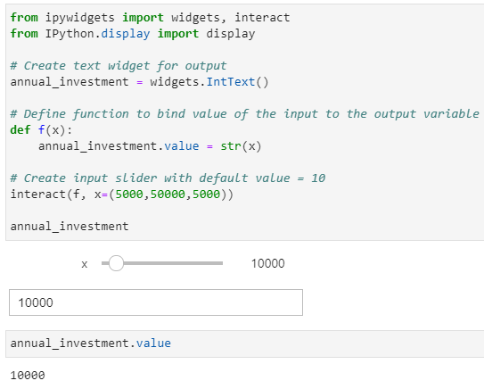
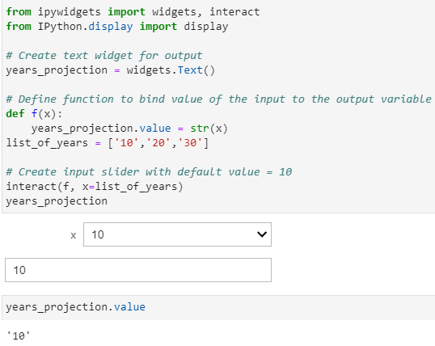
Data Analysis

Slide 20
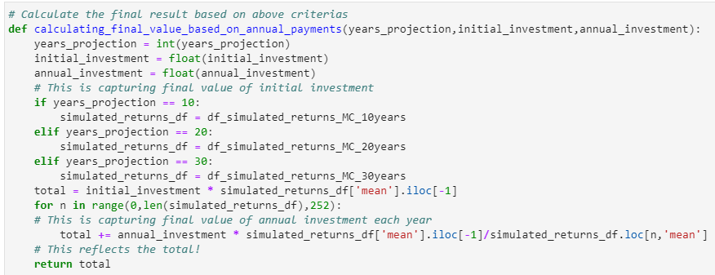
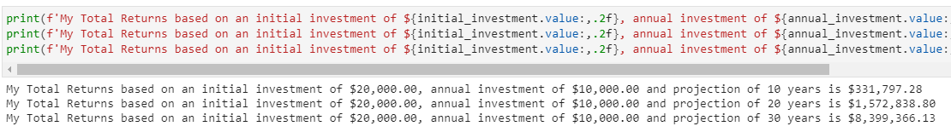
Data Analysis

Slide 21
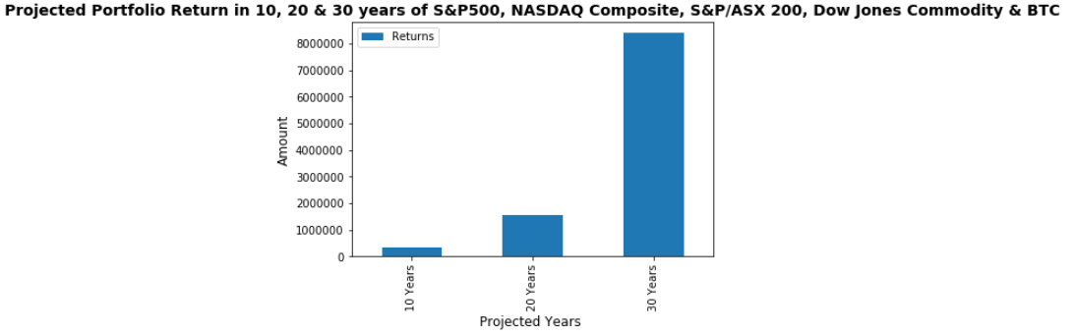
Data Analysis

Slide 22
Data Analysis
Cost of living analysis (Raj)

Slide 23
Data Analysis

Slide 24
Data Analysis

Slide 25
Discussion
Discuss your findings. Did you find what you expected to find? If not, why not? What inferences or general conclusions can you draw from your analysis? >> to be delated
To be done!!

Slide 26
Postmortem
Discuss any difficulties that arose, and how you dealt with them.
Discuss any additional questions that came up, but which you didn't have time to answer: What would you research next, if you had two more weeks? >> to be delated
To be done!!

Slide 27
Questions?

Slide 28
Thank you!!

